Slide 1

Online tax management system

Slide 2
TABLE OF CONTENTS
TEAM MEMBERS
INTRODUCTION
SCHEMA DIAGRAM
ER DIAGRAM

Slide 3

team members

Slide 4
Group members
ROLL.NO | NAME | ROLE
CB.ENU4CSE20215 | DEMADA HARSHITH REDDY | DESIGNER
CB.ENU4CSE20216 | DHANUSH PENUGONDA | LEADER
CB.ENU4CSE20221 | GUTHA VENKAT SAI | TESTING AND DOCUMENTING
CB.ENU4CSE20232 | KODURU VIVEK SAI REDDY | DEVELOPER

Slide 5

INTRODUCTION

Slide 6
INTRODUCTION
The main aim of our project is to prepare a Tax summary or Tax Returns of a client. In Tax Information System, a client registers himself enters all the details and uploads various Documents that are necessary for preparation of Tax Summary and Schedules for an interview after successful submission of all the documents. After all the procedures are completed Tax Returns or Tax summary is prepared for all the clients by the admin who calls the clients and arranges an interview for discussing various issues regarding Tax summary.

Slide 7
Functionalities of the system
In this online tax management system, there are many reports like client profile, schedule status, payment status, admin and client report and so on. In this system, if a new person enters the site, they can register themselves and provide their details and will be provided with credentials to login and store or view their reports in the database. The registered client can upload the documents associated with their tax generation. They can schedule their convenient time and date for the Tax interview. A summary report will be generated based on submitted documents and the interview. Based on Tax summary report the client can pay their taxes through the system. After the Tax being paid another report will be generated.

Slide 8
​
​
Modules in the system :​
​
​
This system includes the following modules
Interface creation for tax table management.
Register and create client profile
Schedule tax interview
Generating a payment report
Accepting the payment from the client
Generating the E-File acknowledgement report
Benefits of the system :
This system supports the management, clients and admin by providing them necessary information. This system also can generate different reports based on the requirement.

Slide 9

SCHEMA DIAGRAM

Slide 10
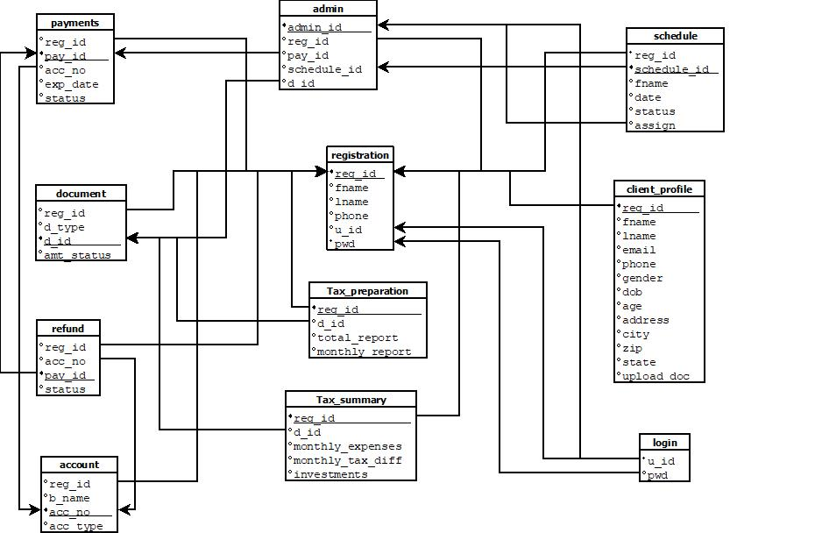

Slide 11

ER DIAGRAM

Slide 12
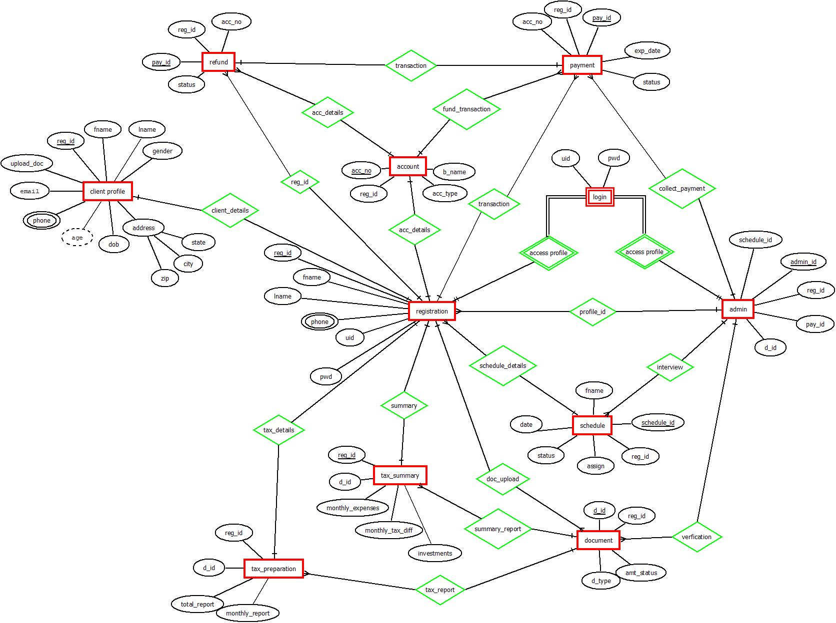

Slide 13
THANK YOU

